Slide 1
Capstone Project-Battle of The Neighborhoods
Marc-Henri Bleu-Laine
July 2019

Slide 2

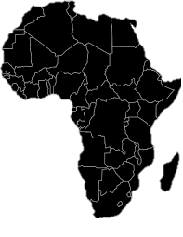
Background
Opening an African restaurant in the city of Atlanta is a though problem for business owners
Which location is best?
Where is the competition?
Is the location safe?
Is it expensive to rent?
Taking into consideration all these parameters and more adds complexity
Solving this problem can lead to more people opening their restaurants
Spreading of the overall African Culture
Potential large market due to small competition (limited number of African restaurants)

Slide 3
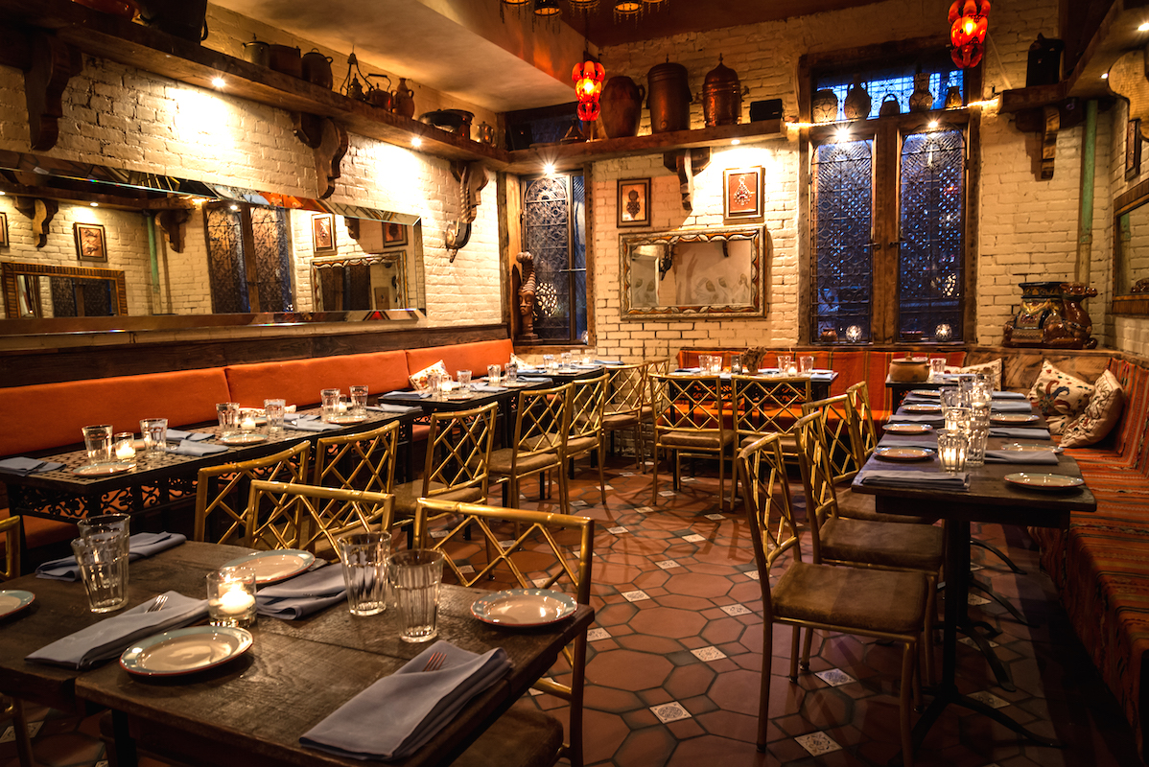


Problem Statement
Determining the optimal location to open an African restaurant in Atlanta, GA
For this project the optimal location is defined as:
Top places of the neighborhood are restaurants
No direct competition with other African restaurants
Low crime rate
Cheap rent

Slide 4




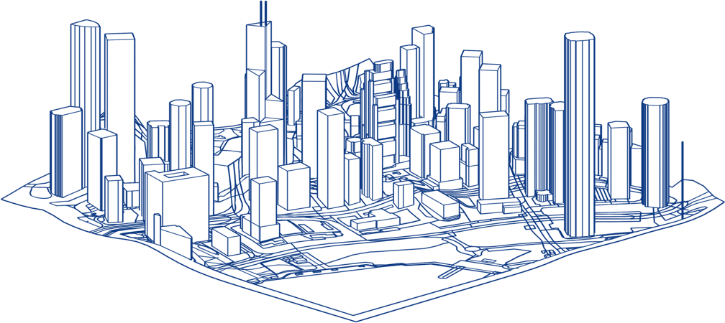

Data Description & Methodology
dataflow
K-Means Algorithm
Creates clusters of neighborhoods
Zillow
Provides rent of different neighborhoods for year 2019
Final Dataset
Per neighborhood: most common venues, crime rates, average rent, number of African restaurants
TOPSIS
TOPSIS
Allows selection of a cluster of neighborhoods
APD COBRA Dataset
Provides 2019 crime counts and types in the city of Atlanta for a given neighborhood
Ideal cluster determined
Further Analysis can be done to select one final neighborhood
Foursquare
Provides venues in all neighborhoods (using combined neighborhoods from the two other datasets)
Other features are names, coordinates, and categories

Slide 5
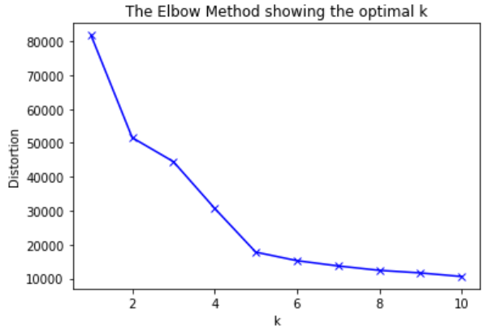
Neighborhood Clustering
Before using K-Means to cluster the neighborhoods in the final dataset, the elbow method was used
The method consist in finding the percentage of variance contained in the clusters.
As more clusters are added, more variance is explained by them.
After some point there is diminishing return in adding more clusters (variance is only slightly more explained with additional clusters), the number of cluster at that moment is then the optimal one
The ideal number of clusters found was 5
Diminishing return
K-Means from the sklearn library is used to cluster
It initially randomly establish a number of centers k for the clusters, then find the distance from all the points in the dataset to these centers.
The points that are closer to a center are considered to be in the same cluster
New centroids can be found by averaging the points in a given center, and new distance from the data points to the centroid can be calculated
The process is repeated until convergence is achieved (centroids no longer move)

Slide 6
Neighborhood Clustering-Cluster Descriptions
Cluster 0
The second largest cluster created
Contains most of the African restaurants
Highest crime rate
Highest average rent
Diverse neighborhoods in terms of venues but seems to contain the most food places in its most common ones
Cluster 2
It has the second lowest crime rate
Quite a good amount of restaurants in its most common venues
Has two African restaurants
Second highest rent
Cluster 4
Third largest rent
Okay amount of restaurants
One African restaurant
Third largest crime rate
Cluster 1
Smallest cluster
Lowest rent price
No African restaurants
Lowest crime rate
Does not look appealing in terms of restauration (only the 7th and 10th most common venues are ones)
Cluster 3
It has no African restaurants
It is the second largest cluster and has the second largest crime rate
Average rent is on the lower sideAn okay amount of restaurants (lots of fast-food)
Second largest crime rate

Slide 7
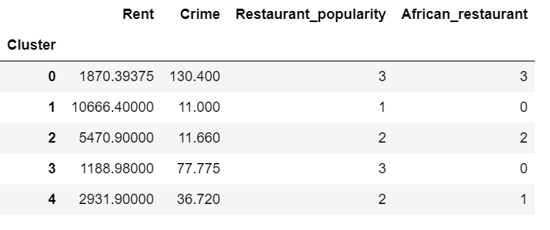
Decision Making
A variant of the final dataset was used
After exploring the clusters, the restaurant popularity feature was created
Ranked from 3 to 1 with 3 being a cluster with a high overall restaurant count and 1 being a cluster with a low count
Other features were number of African restaurants, crime rate, and average rent
Technique for Order Preference by Similarity to Ideal Solution (TOPSIS)
Used for multi-attribute decision making
Internal scale needs to be chosen for qualitative data (restaurant popularity)
Stakeholder specifies direction of the feature (minimize average rent for example) and the relative importance by associating it with a weight
Weights:
0.4
0.2
0.3
0.1
Direction:
Minimize
Minimize
Maximize
Minimize

Slide 8
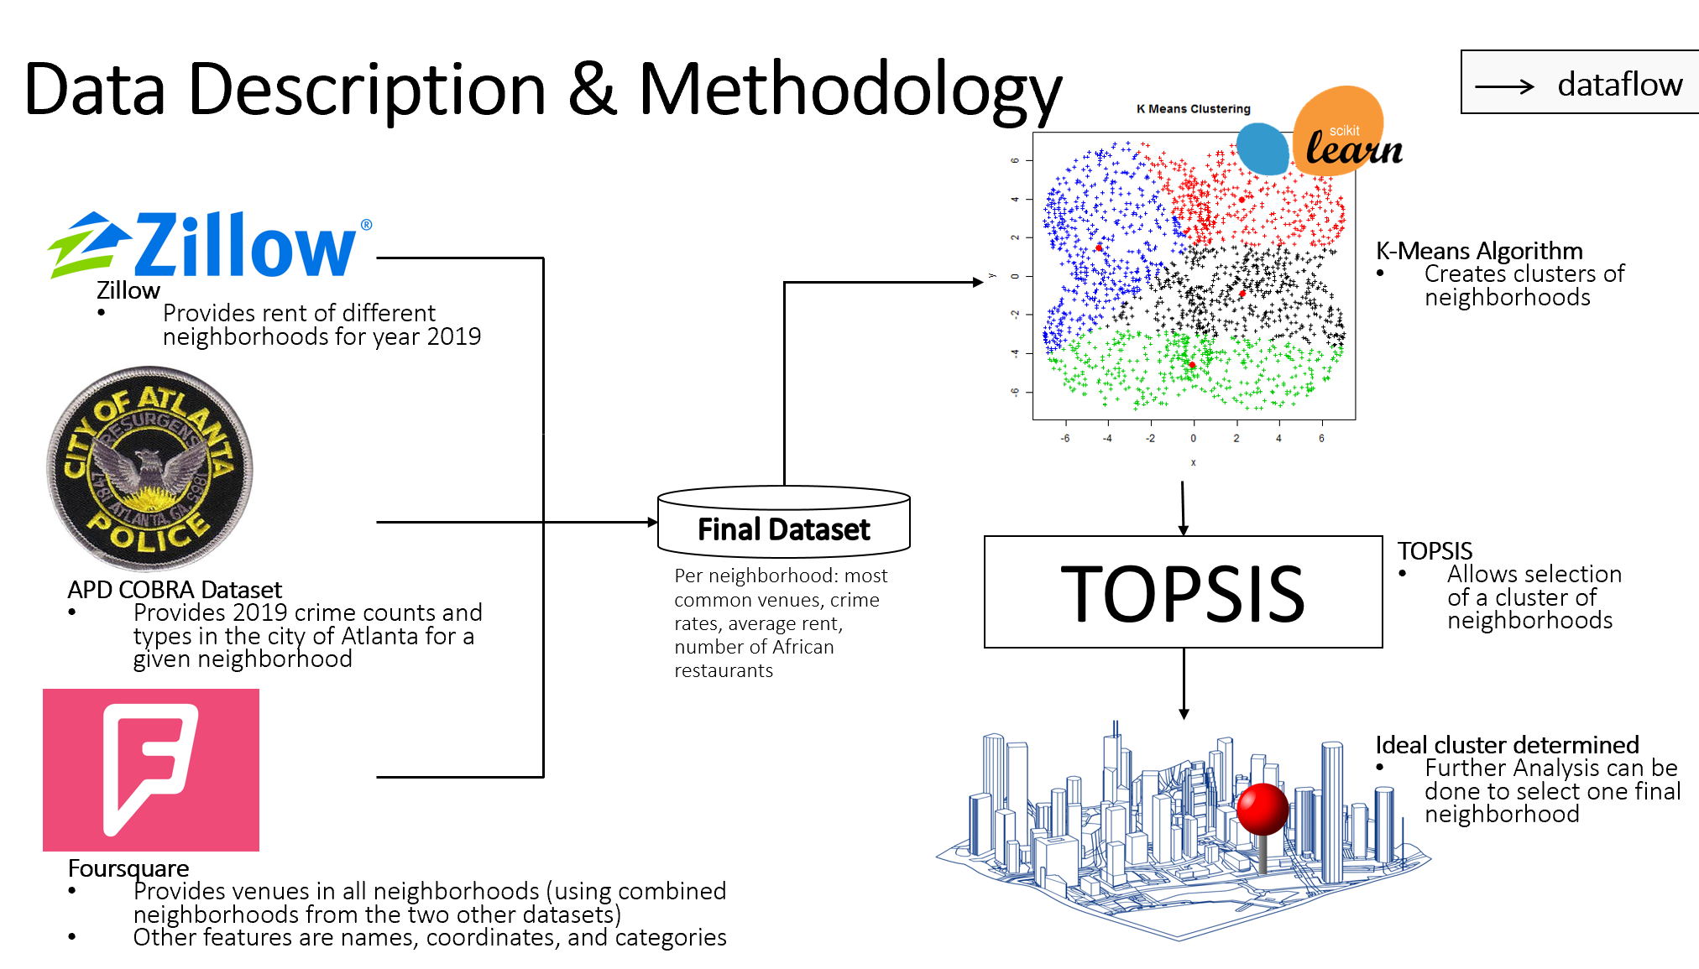
Result & Conclusion
The goal of this work was to help potential business owner to open an African restaurant in the city of Atlanta, GA
Cluster 3 was found to contain the best neighborhoods based on the data and the preferences that were used. The final choice of the neighborhood is left to be done by the stakeholder
The methodology included fusing multiple datasets and using the newly created one to cluster the neighborhoods using machine learning. The methodology also included a decision making step to select which cluster contains the best neighborhood
For future work it would be useful to:
Include the ranking of the venues to see which one you are competing against
Acquire missing data for some neighborhoods so that they can be included in the cluster
Add the different types of crime in the dataset and weight them differently
Cluster within a cluster to find even more insights about the neighborhoods
More rigorous quantification of restaurant popularity could be done

